Slide 1
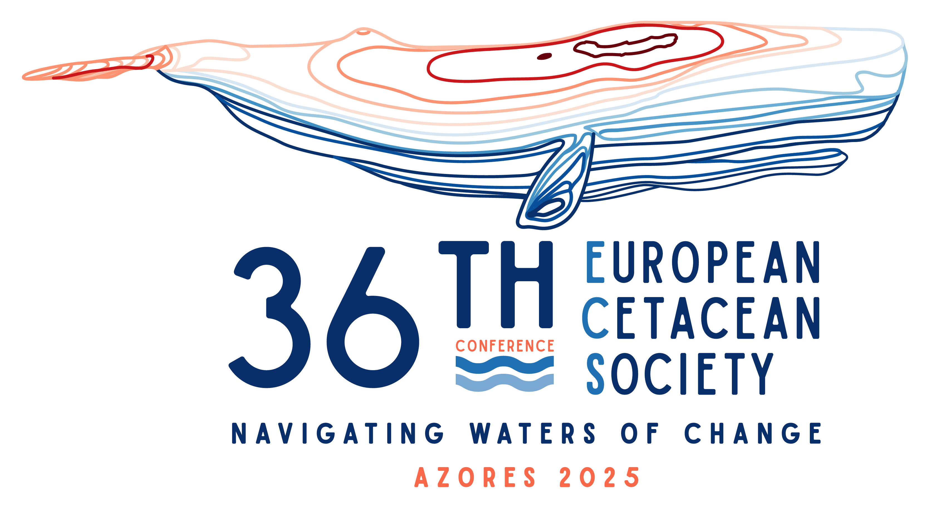




ECS Student workshop
Environmental variable download and processing with R
Miguel Martins (CEAUL, AIMM); Moritz Klaassen (MARE); Catarina T. Fonseca (OKEANOS)
Second session

Slide 2
Goals
Data Discovery: Find the most relevant open marine-environment portals and know what each offers.
Raster Handling: Import, visualise and stack environmental rasters in R with terra and sdmpredictors.
Spatial Subsetting: Crop and re-project global layers to any study area.
Data alignment: Combine presence–absence points with extracted predictor values for modelling-ready output.

Slide 3
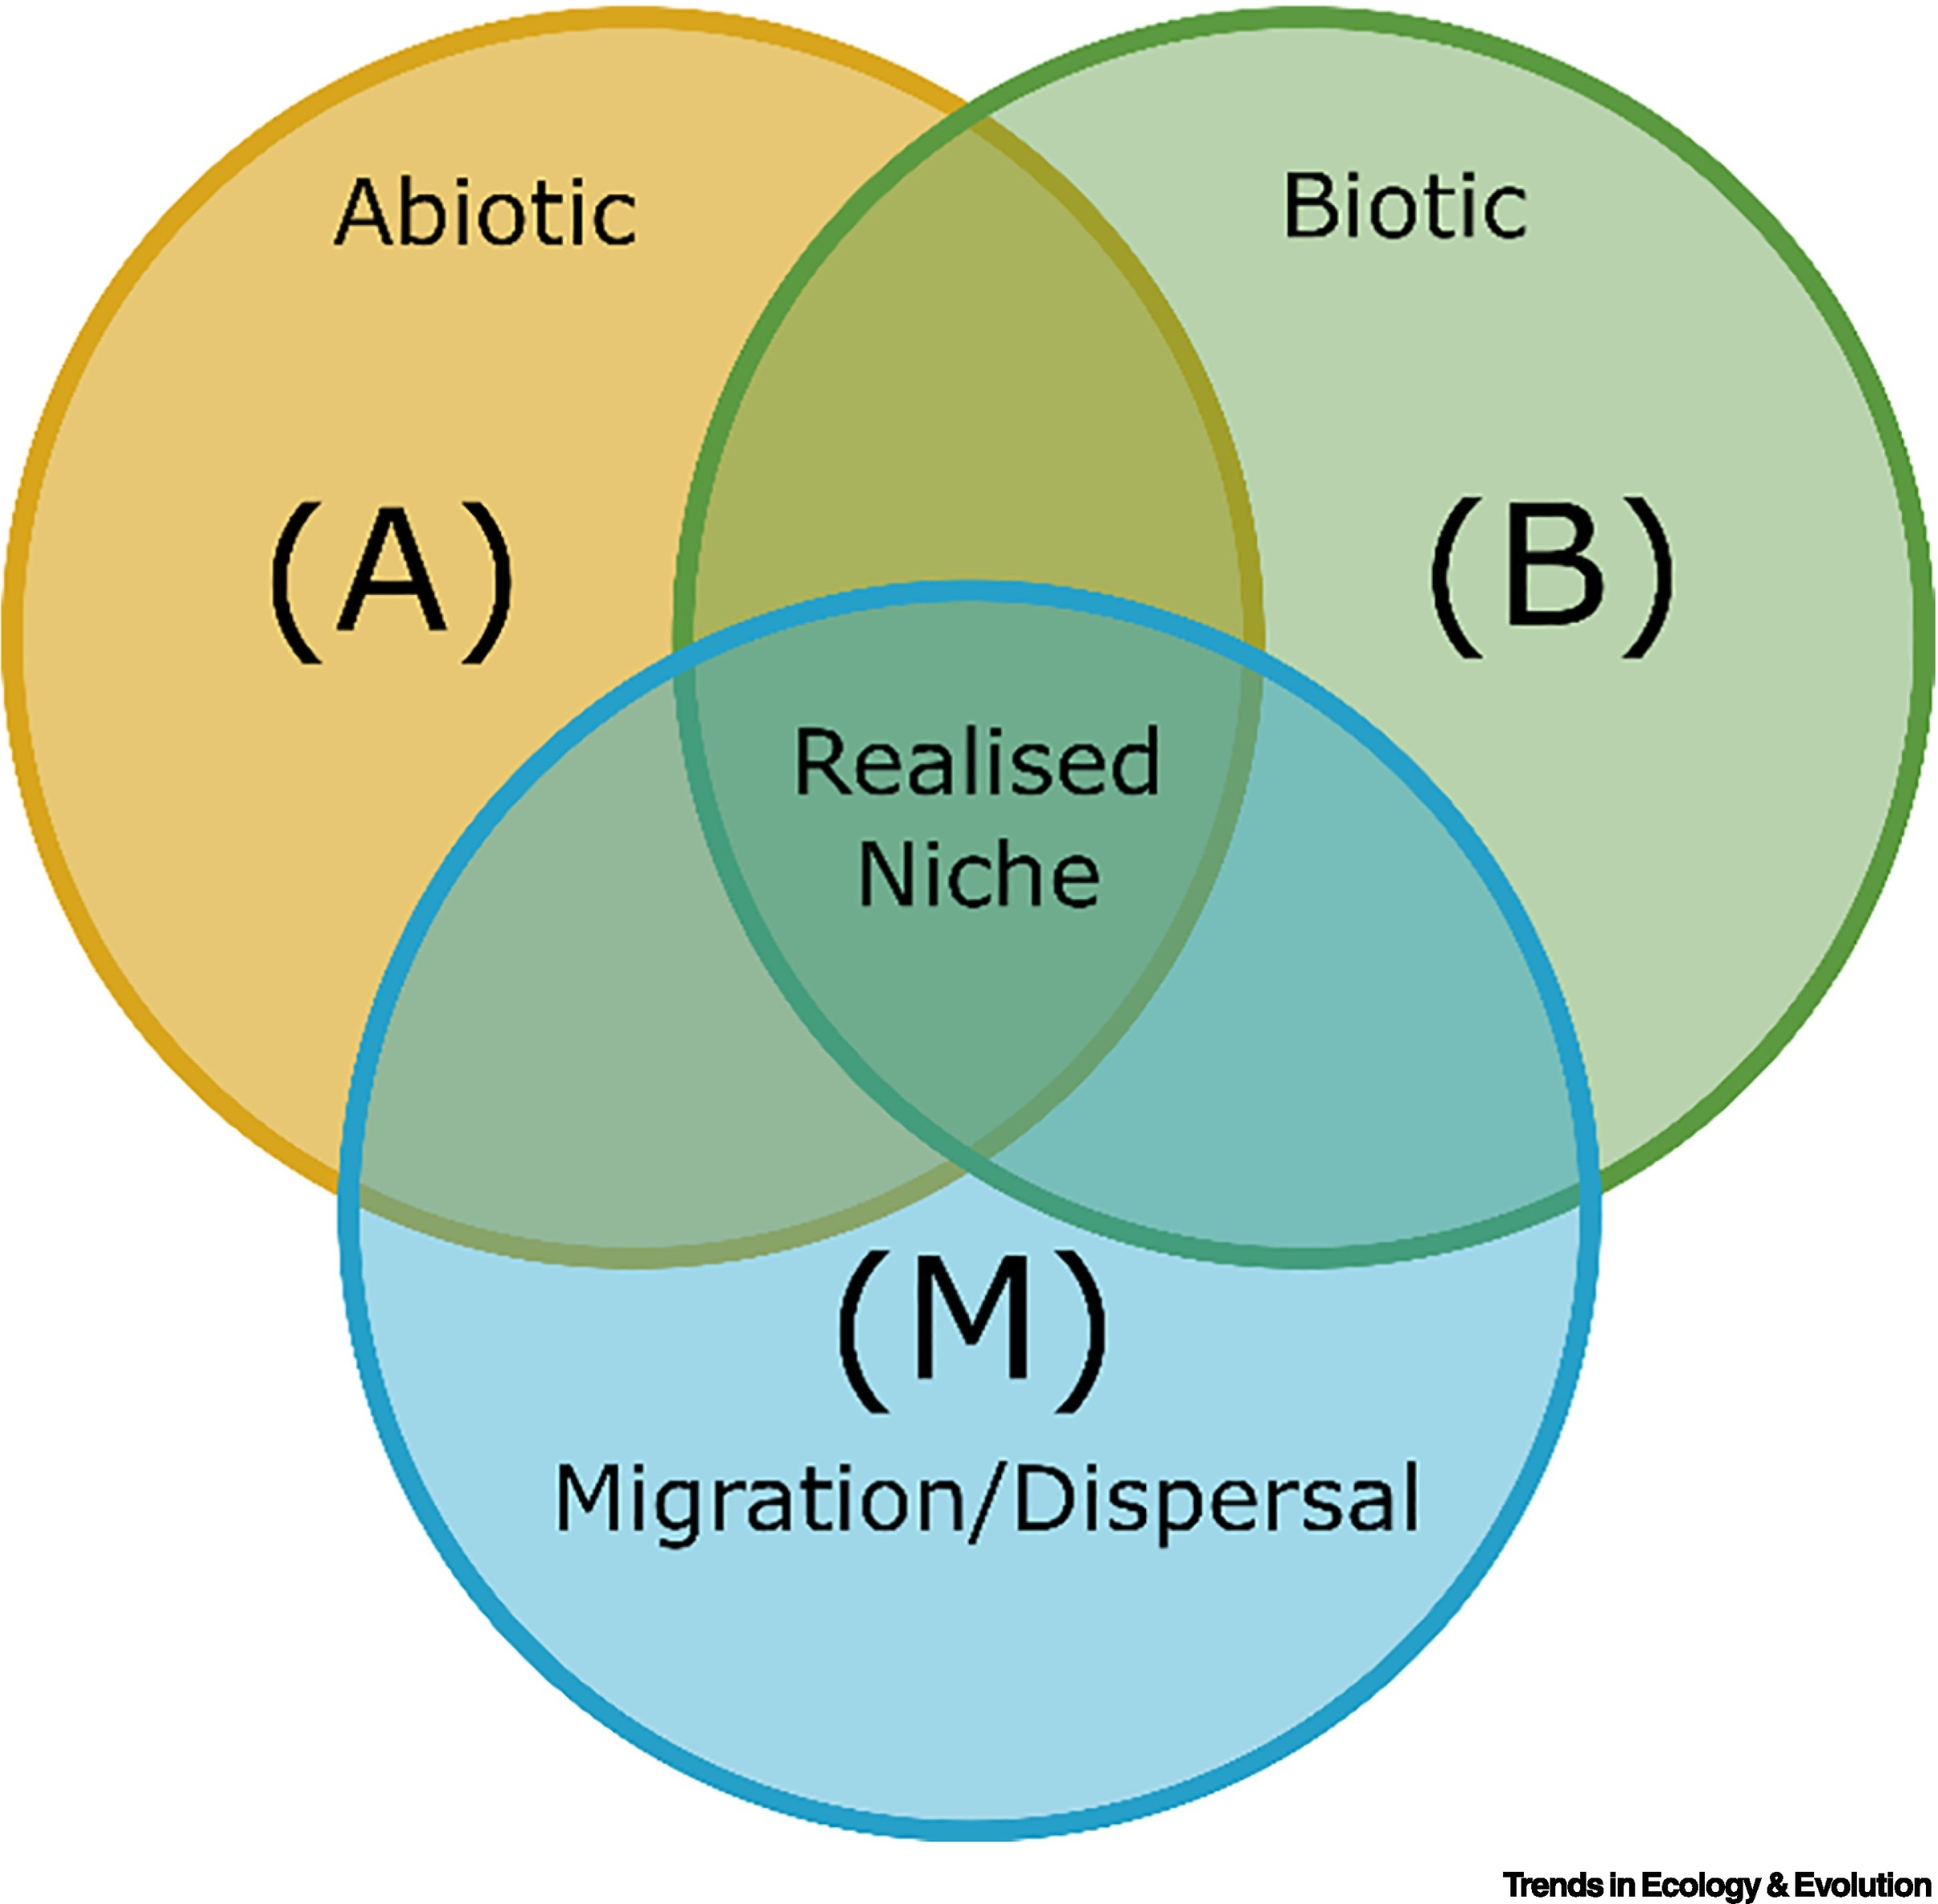
What are environmental variables?
Factors that influence the living organisms and their habitats.
Abiotic (physical & chemical)
Climate: temperature, precipitation,radiation
Bathymetry: depth, slope, aspect
Hydrology: salinity, nutrients, pH
Biotic (living systems)
Species occurrences, abundance, traits
Biomass, primary productivity

Slide 4
Realms & sub-realms
Realm | Typical sub-realms | Example variables
Marine | Epipelagic, benthic, coastal, open-ocean | SST, chlorophyll-a, currents, pH
Terrestrial | Forest, grassland, desert | Land surface temp., soil moisture, snow cover
Freshwater | Rivers, lakes, wetlands, groundwater | Discharge, turbidity, lake surface temp.
Take-home: Environmental data span physical and biological conditions across marine, terrestrial and freshwater realms, delivered at multiple spatial and temporal resolutions.

Slide 5
Environmental data sources
Satellite remote sensing – e.g. SST, chlorophyll-a, sea level, wind, ice
In situ observations (CTD casts, Argo floats, moorings, buoys, sediment cores) - e.g. salinity, pH, nutrients
Numerical models & reanalyses (coupled physical-biogeochemical outputs, forecasts) - e.g. mixed layer depth, SST at depth
-> Portals re-package this data for direct download.

Slide 6


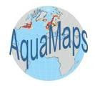






Environmental data sources
https://www.noaa.gov/climate – global SST (OISST), subsurface profiles, long-term ocean-climate records.
https://marine.copernicus.eu/ – Copernicus Marine Service (CMEMS): near-real-time & reanalysis fields of SST, salinity, currents, sea-level, biogeochemistry, sea-ice, waves.
https://www.aquamaps.org/ – modelled distributions for > 33 000 marine species; underlying environmental rasters downloadable.
http://www.bio-oracle.org/ – rasters of SST, salinity, nutrients, pH, currents, ice & light (present + future scenarios).
http://www.marspec.org/ – similar products to bio-oracle
https://earthengine.google.com/ – cloud catalogue that includes many marine satellite products (NOAA OISST, MODIS chlorophyll-a, sea-level anomaly, etc.).
https://www.pangaea.de/ – repository with extensive oceanographic expedition data (CTD, sediment cores, biogeochemistry) and some terrestrial sets.
https://oceancolor.gsfc.nasa.gov/ - global chlorophyll-a and other ocean-colour products

Slide 7

Copernicus marine service (CMEMS)
Physical / “blue-ocean” layers – sea-surface temperature & salinity, currents, sea-level anomaly, mixed-layer depth, waves.
Sea-ice / “white-ocean” layers – concentration, thickness, drift.
Biogeochemical / “green-ocean” layers – chlorophyll-a, nutrients, dissolved oxygen, pH, primary production, carbonate system.

Slide 8

MARSPEC
geophysical and climatic data layers derived from in situ and satellite observations
geophysical layers; bathymetry dataset and include depth, slope, aspect, and curvature of the seafloor, as well as distance to nearest shoreline
climatic layers derive from NOAA’s World Ocean Atlas and NASA's Ocean Color Web and characterize observed inter-annual means, extremes, and variance in sea surface temperature and salinity

Slide 9
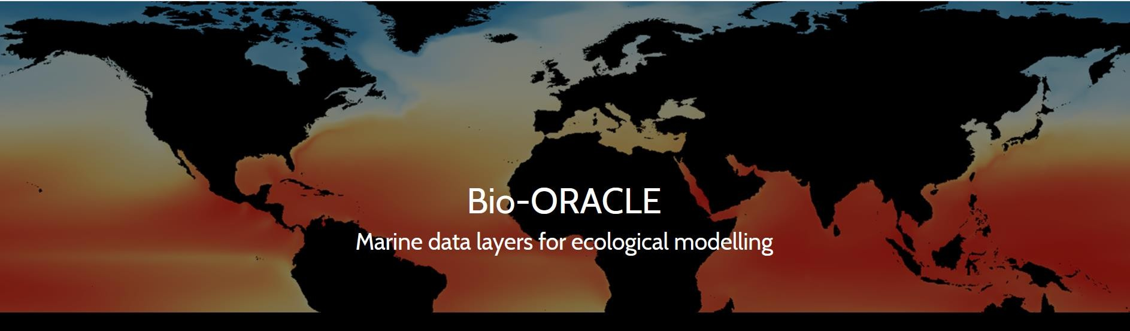
Bio-ORACLE
geophysical, biotic and environmental data for
surface and benthic marine realms
5 arc-minute resolution (~9.2 km² at the equator)
present and future

Slide 10
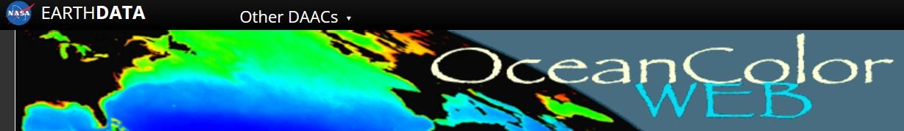
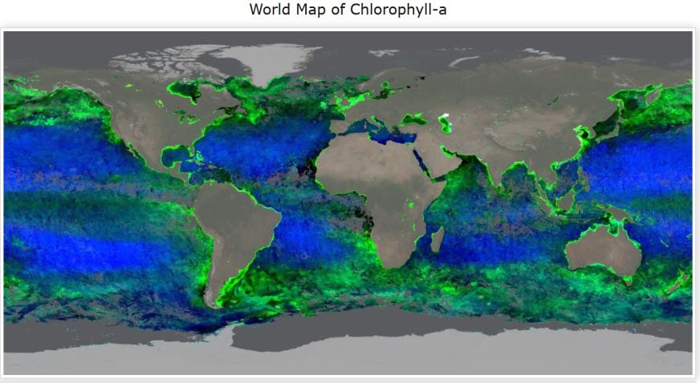
Ocean Color Web
ocean-related products from a large number of operational, satellite-based remote-sensing missions
ocean colour, sea surface temperature and sea surface salinity

Slide 11
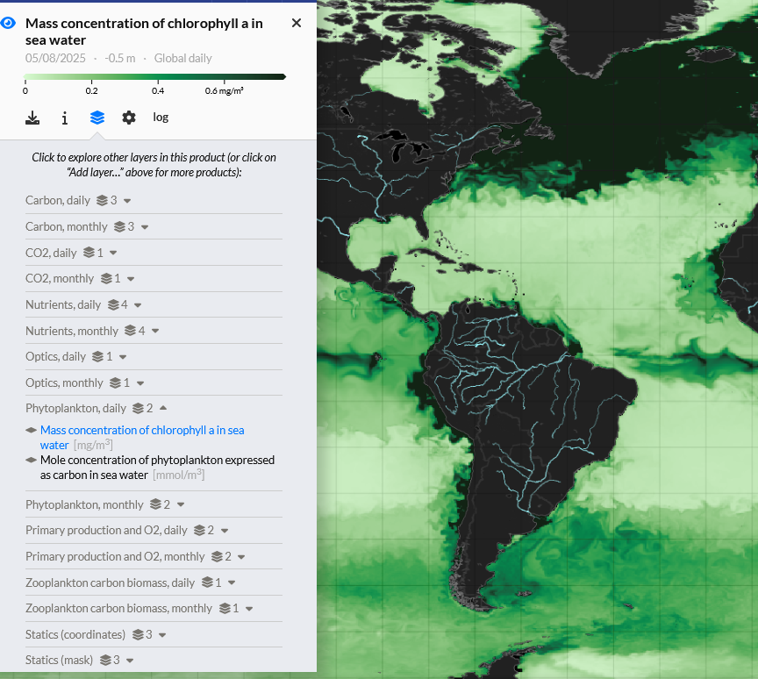
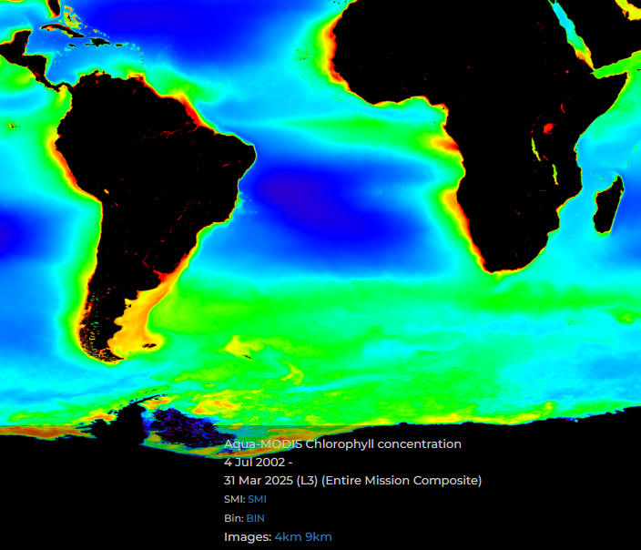
Exercise: explore these databases (~15 min)
Suggestion 1: https://marine.copernicus.eu/ -> DATA / OCEAN PRODUCTS -> select any product of choice -> Explore in MyOcean Pro -> play around with layers, regions and time
Suggestion 2: https://oceancolor.gsfc.nasa.gov/ -> DATA -> Find data -> Level 3 & 4 Browser -> Select at least weekly resolution (stack enough orbits to fill most cloud and swath-gap holes) -> play around with layers, regions and time

Slide 12
Practical
Before we dive into the hands-on session, let’s walk through the script step by step.
You can already open the script in the course material (Env_variables.R) but you will be given sufficient time after the presentation to run things on your own time

Slide 13
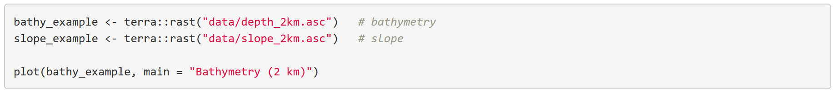
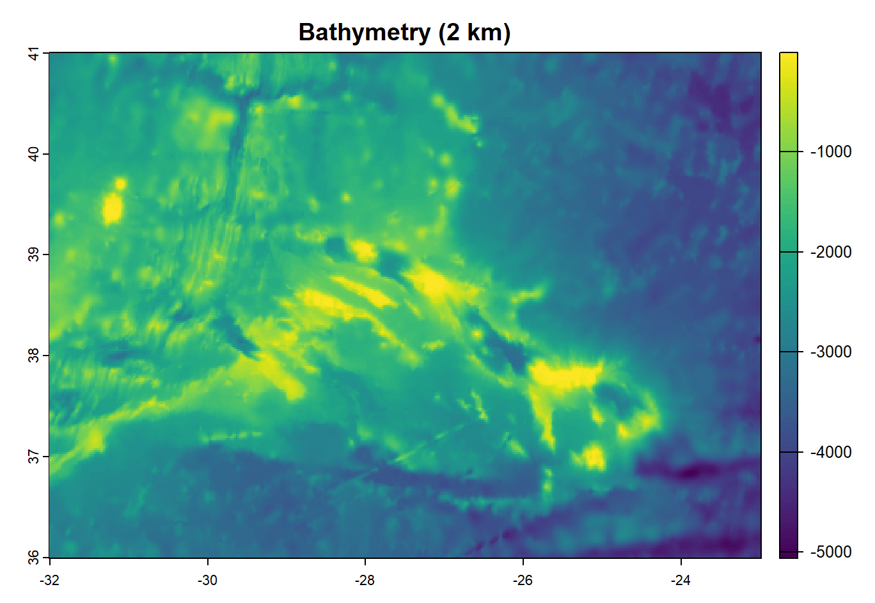
1. Import local files
if we have our environmental data already downloaded, we can simply load it into our R session

Slide 14
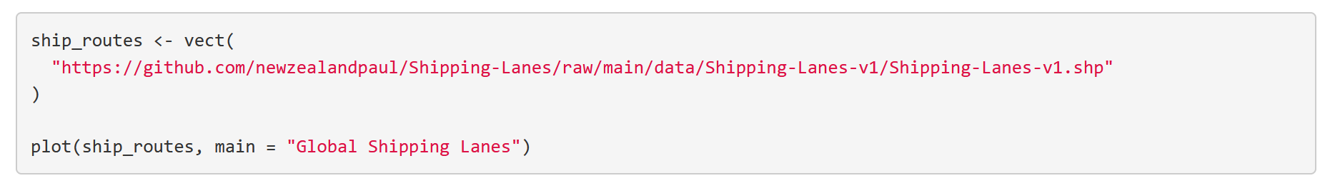
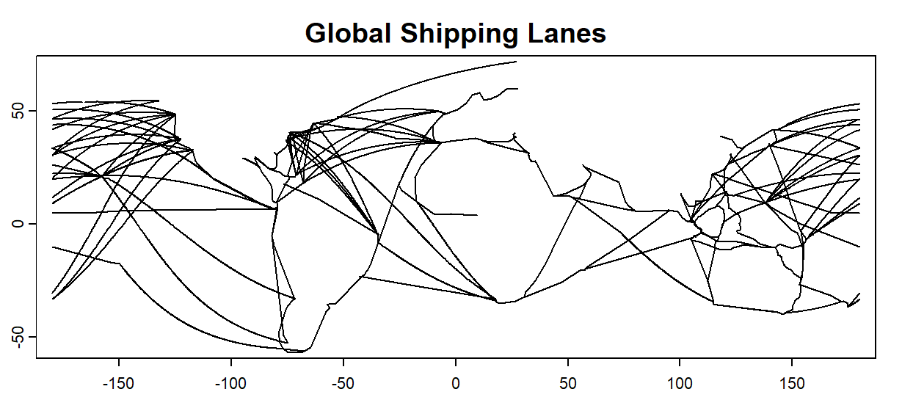
2. Import raster from download link
if we have our environmental data not downloaded yet, we can use a download link to directly load it into our session

Slide 15
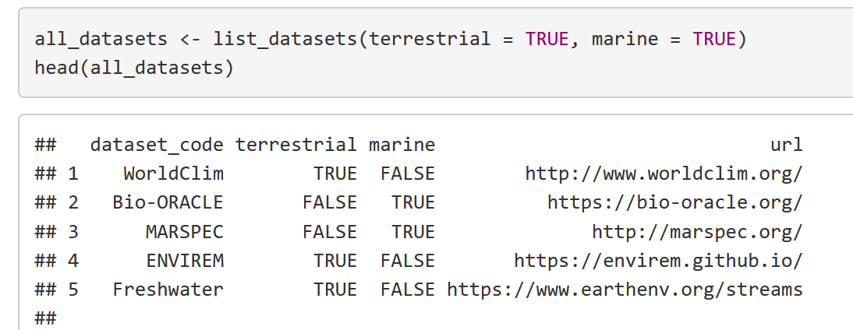
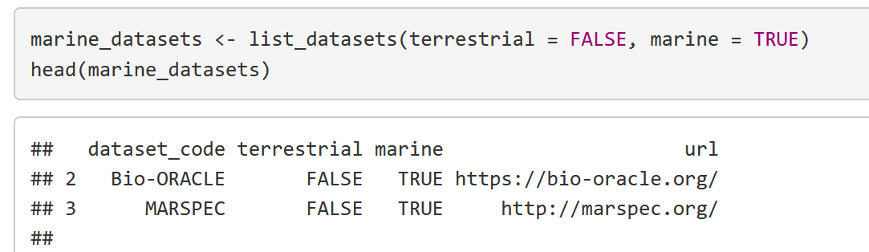
3. Import environmental data through sdmpredictors package
if we have our environmental data not downloaded yet, we can use a the sdmpredictors package to import data from MARSPEC and Bio-Oracle (for marine data)

Slide 16
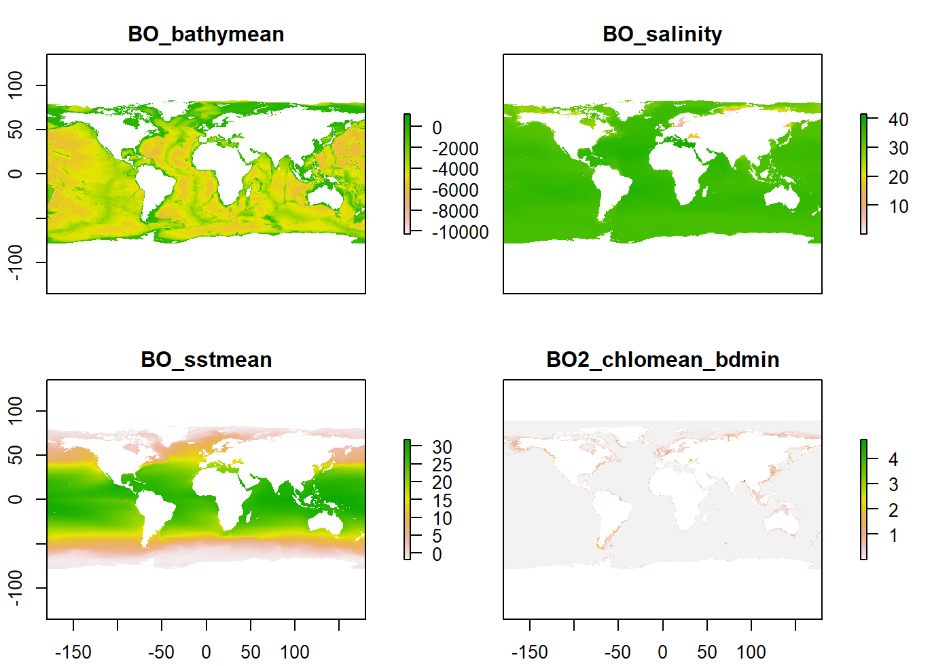
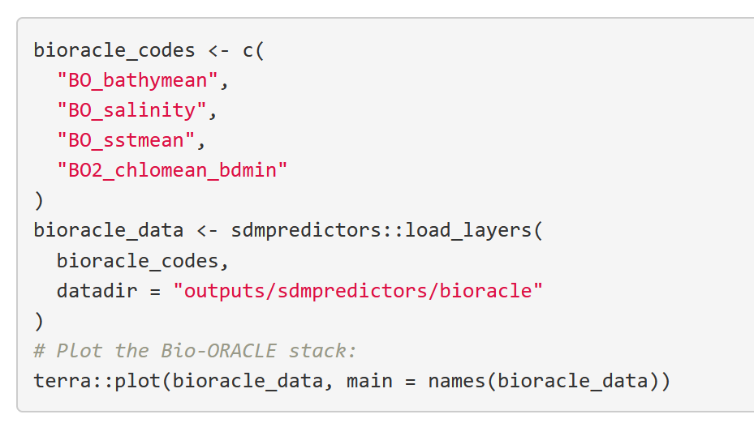
3. Import environmental data through sdmpredictors package
We can list all the environmental variables that we can download using this function:
Using the same function, we can download the variables that interest us:

Slide 17
3. Import environmental data through sdmpredictors package
We can list all the environmental variables that we can download using this function:
Using the same function, we can download the variables that interest us:

Slide 18
Exercise: organize in working groups of ~4 people. Run the script (Env_variables.rmd) (~30 min)
1. Run the script (Env_variables.rmd). Pay attention to the comments in the script!
2. Select some variables of interest from Bio-Oracle or MARSPEC, download them via sdmpredictors and plot them in your region of interest

